Slide 1
Examining Short-lived Radionuclide Creation in Supernovae Simulations
Charlotte K. Johnson
Dr. Patrick Young
Department of Physics, School of Earth and Space Exploration
Arizona State University

Slide 2
Purpose
Computational models provide:
Guidance for observational data collection
A resource for interpreting observational data
Simulated information that cannot be recreated experimentally on Earth
Provide insight into the history of our own solar system
Ratios of short-lived radionuclides (SLRs)
Heat source for differentiation
Notes:
Excess SLRs indicate interaction with supernova (we propose)
Heat source esp. Al26, forming planets, etc

Slide 3
Progenitor Star and Supernova
15 M☉ Red supergiant
Asymmetric explosion
Velocity 1.5 times greater at the poles compared to the equator
Velocity decreases as a sine function from the poles to the equator
TYCHO stellar evolution code
Notes:
Solar metallicity

Slide 4
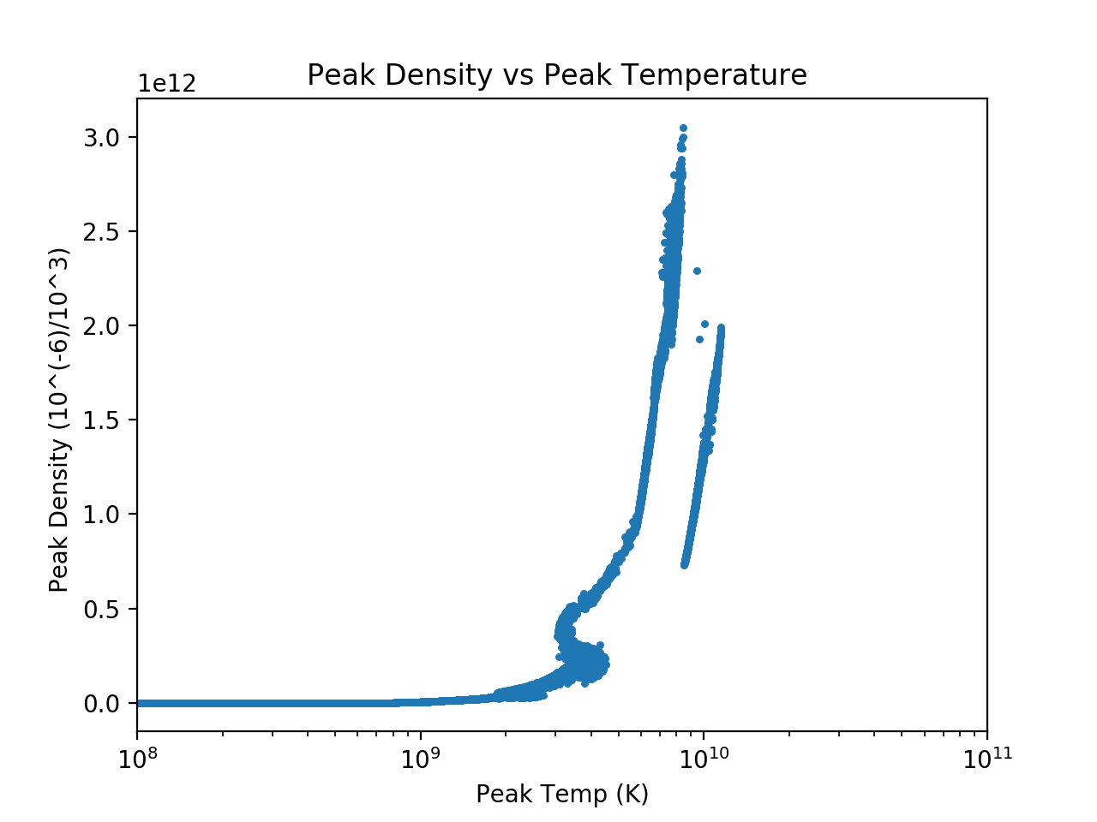
Asymmetrical jet
Temperature and density combination effect supernovae processes

Slide 5
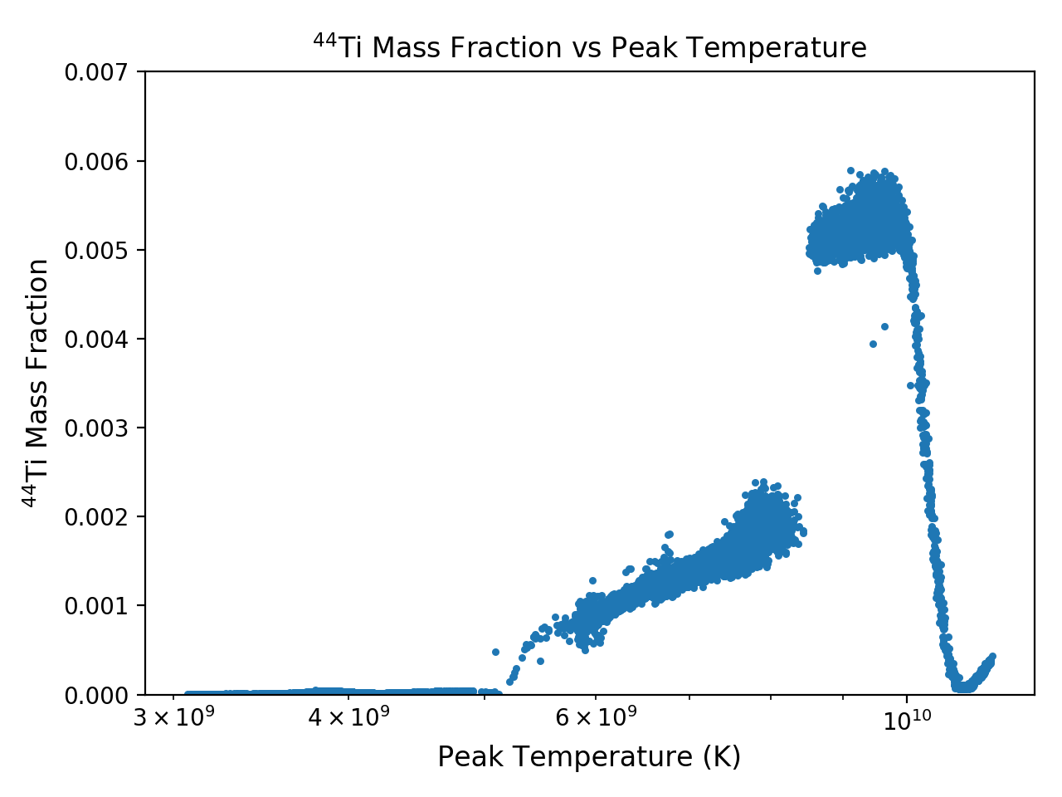
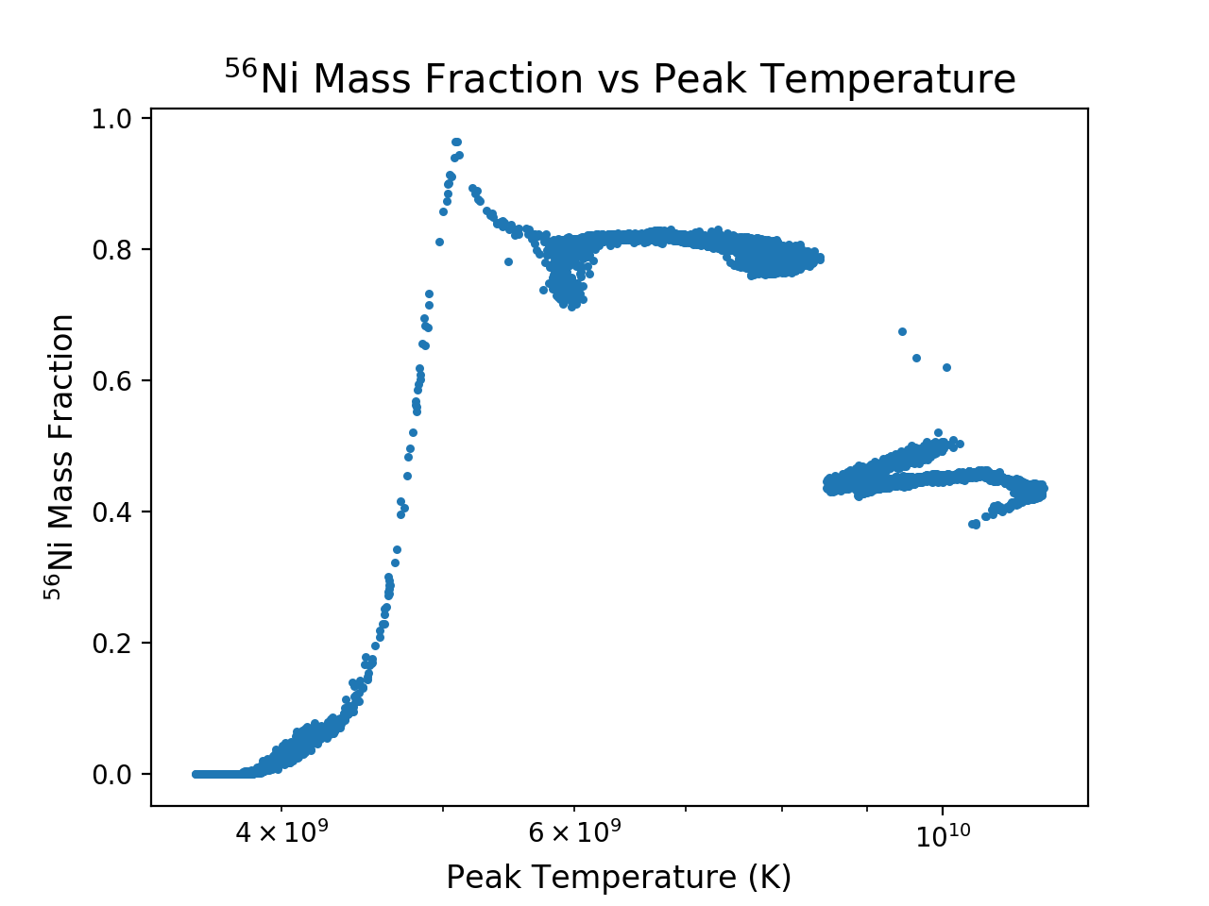

Slide 6
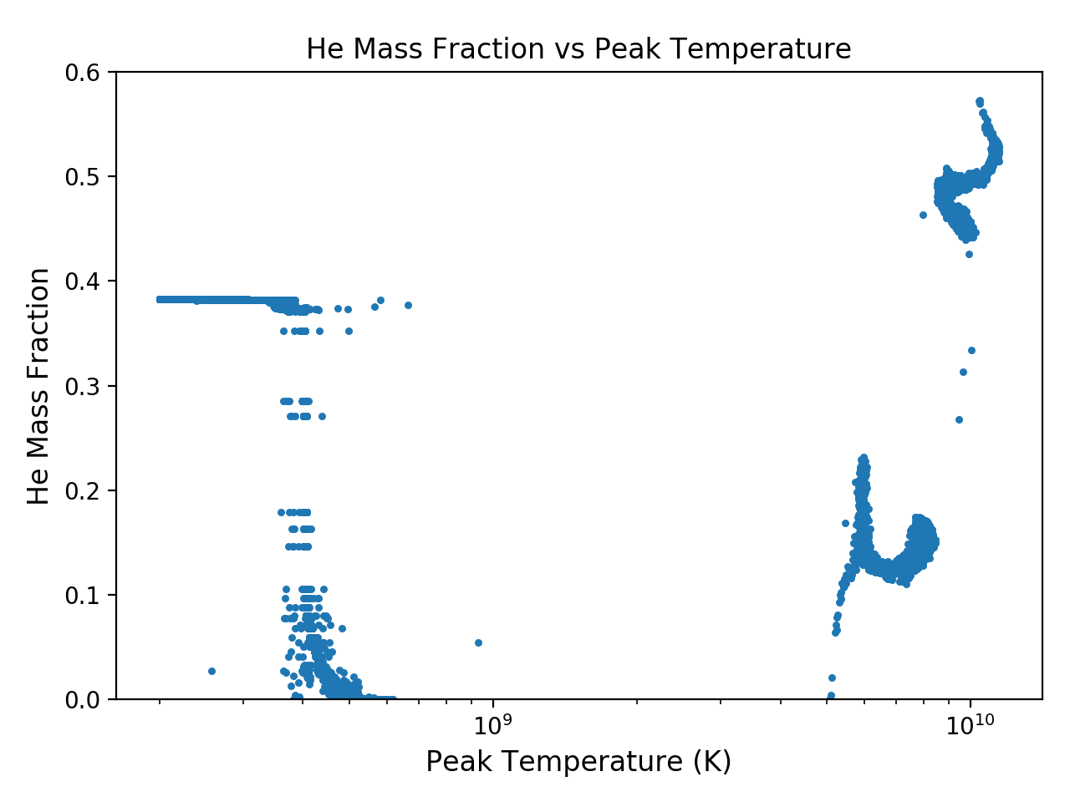
⍺-rich Freezeout
High temperature (~10¹⁰ K) peaks of ⁴⁴Ti and ⁵⁶Ni
He production peak at ~10¹⁰ K

Slide 7
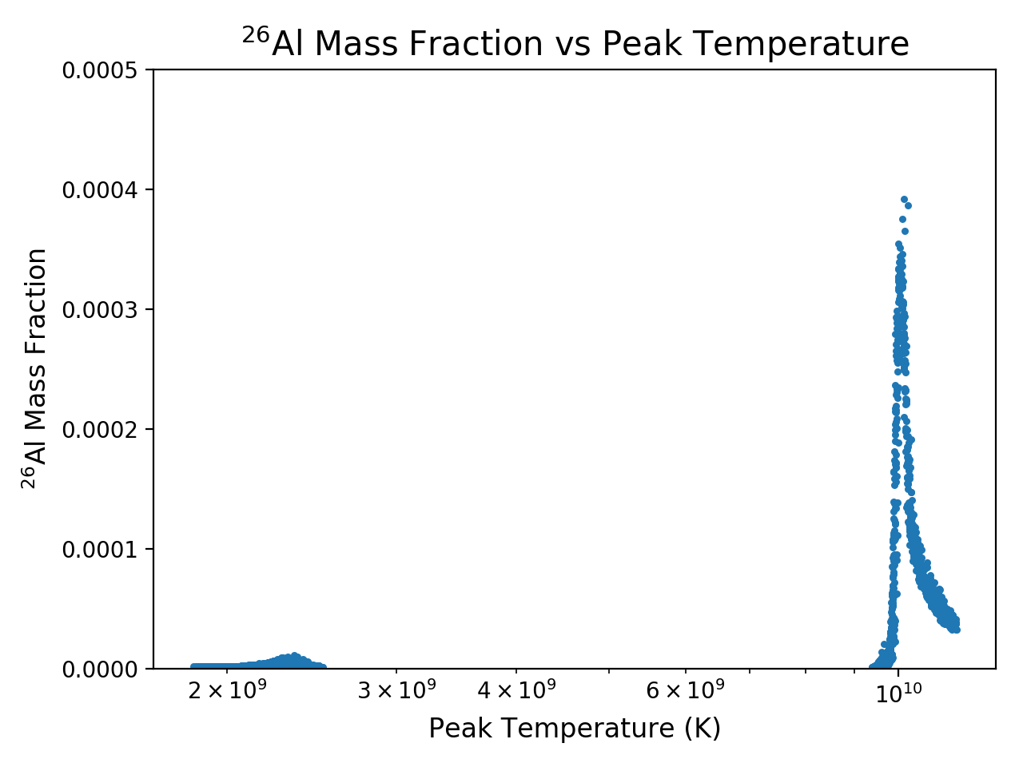
²⁶Al as a Heat Source
Short half-life of 717,000 years
Traces of ²⁶Mg found on Earth
Differentiation of small-mass celestial planetary bodies
Vesta

Slide 8
Future Work
Further explore SLR ratios
Explore additional supernovae geometry

Slide 9
Thank you!
Special thanks to the ASU/NASA Space Grant Program, Dr. Patrick Young, and Greg Vance

Slide 10
Questions?

